Slide 1

Sharing the Spotlight on Operational Communications in Admissions
Dustin Tarter, Associate Director
Nancy Walsh, Director of Admissions Operations

Slide 2
Agenda:
>What are operational communications?
> Operational Plan
> Audience Considerations
> System Interactions
> Staff Support
> Our Plan
> What are you doing?
> Questions

Slide 3
What Are Operational Communications?

Slide 4
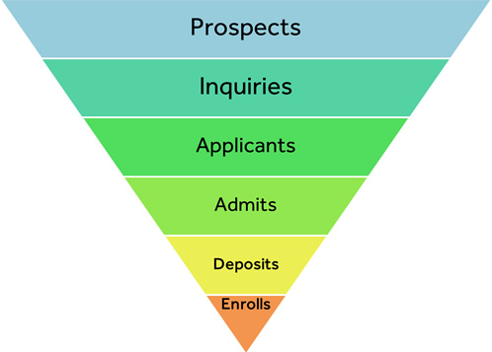
Definitions
A communication that checks-in with your applicant.
These are not marketing oriented communications. These communications are directed towards the applicant and admit portions of the admissions funnel.
Image courtesy of Stony Brook University https://www.stonybrook.edu/commcms/erm/about/process.php

Slide 5
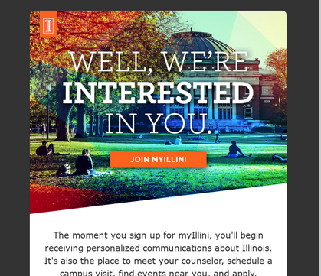

Definitions
An operational communication is not a marketing-oriented communication.

Slide 6
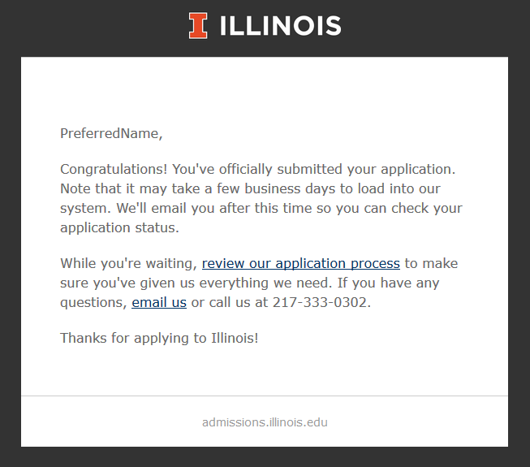
Goals
Assure the applicant that your office cares about their application.

Slide 7
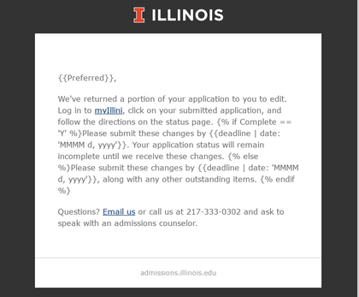
Goals
Encourage an applicant/admit to take a specific action.

Slide 8
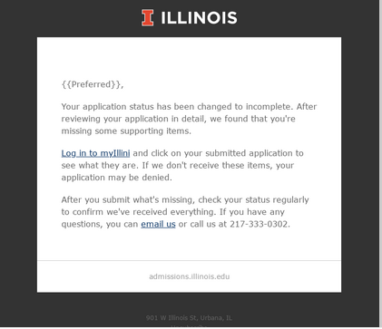
Goals
Inform your applicants that things change.

Slide 9
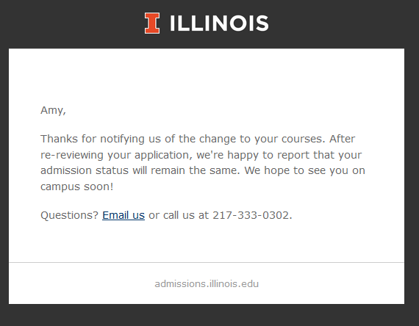
Goals
Update an applicant about a specific action.

Slide 10
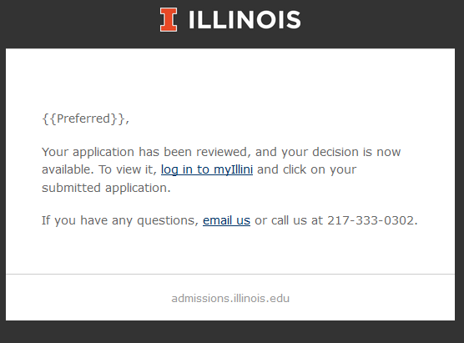
Goals
Share a milestone!

Slide 11
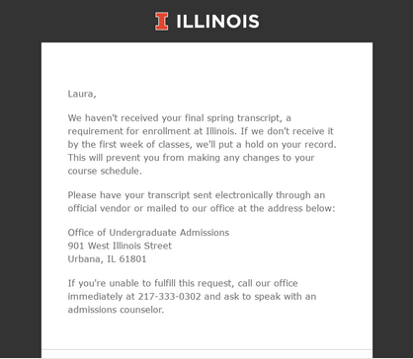
Goals
…and drag them over the finish line.

Slide 12
Methods
Print
Email
Telephone
Text

Slide 13
Benefits
Efficiency
Less need for applicants/admits to contact staff about basic processing tasks.
Consistency
Your applicants/admits have similar experiences.
Analytics
How are your applicants/admits behaving?
Explainable
Eases the burden of onboarding new staff.

Slide 14
Operational Communication Plan

Slide 15
Building Your Plan
1. Who needs to be involved – hint, the answer is not “everyone”!!
2. Who will “own” the plan – this is important!
3. Develop clear objectives – your plan cannot accomplish all tasks!
4. What tools will you need?

Slide 16
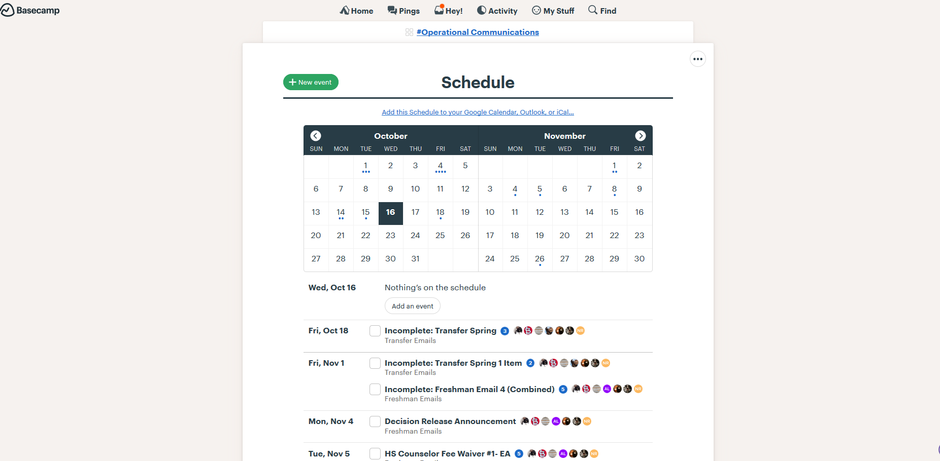
Where Will Your Plan Live?

Slide 17
Audience

Slide 18

Audience
Applicants
Admits
Enrollees
Counselors
Parents

Slide 19
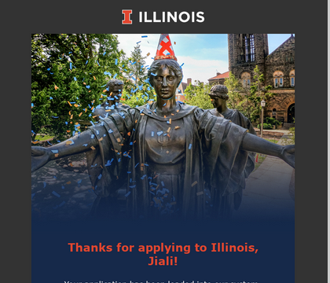
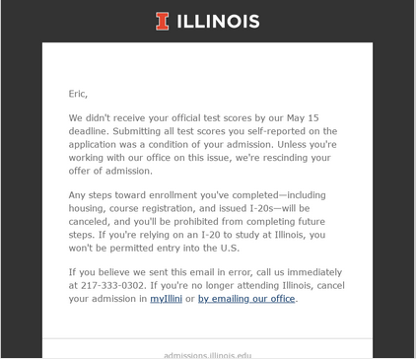
Tone and Context
Tone
How will you approach each audience?
VS

Slide 20
Tone and Context
Context
Who needs to know what?
Do you include counselors in your plan? Parents?

Slide 21
System Interactions

Slide 22
Generating Messages
Automation
- Avoid creating communications that rely on any paper-based functions
- Avoid creating communications that rely on a spreadsheet which needs to be manually pulled
System Fields
- Identify which type of admissions data can trigger automated messages
- Where is the data stored?
- May need to build feeds from other systems into your CRM/communication manager

Slide 23
Setting Message Tones
Friendly Messages/Reminders
- Thanks for applying!
- Early messages in a campaign
Not So Friendly Messages/Reminders
- Later messages in a campaign; need materials now or you will be denied!
- Post-admission messages; need materials now or you will be rescinded!

Slide 24
Balance of Contact
Recruitment Marketing Campaigns
- Need to think about where operational communications fit in calendar-wise with the other messages going out
- Need to consider the tone of the recruitment messages going out & how operational communications fit in with those
Operational Campaigns
- Need to be familiar with all operational campaigns & must make sure that you don’t send conflicting messages to applicants
- Need to think about how often you want to remind applicants of a must-do without pestering them too much into no action (especially if text messaging is used)

Slide 25
Testing Messages
- Need to ensure that your messages make sense & have no typos
- Need to ensure that your messages have correct audience logic as well as text logic (if appropriate)
- Send test emails to staff to check before operational campaigns begin
- Continual monitoring through application cycle; need to make sure that emails are being sent appropriately

Slide 26
Staff Support

Slide 27
Building a Team
Operations Staff
- Identify needed communications
- Familiar with needed logic
Communications Staff
- Draft communication content
- Establish consistent tone based on message
- Familiar with overall communication campaigns
Data/Systems Staff
- Pull audience and help identify logic
- Familiar with admissions data as logic points
Recruitment & Outreach Staff
- Need to understand what is being sent operationally
- Can answer questions

Slide 28
Our Plan

Slide 29
Illinois’ Operational Communications
All undergraduate applicants
- Application submission & application fee receipt
- Application status page available
- Acknowledge receipt of online change forms
- Incomplete campaigns
- Complete-to-incomplete
- Student Discipline/Criminal History cleared
- Decision available
- English Placement Test registration
- I-20 Ready
- Delayed admission approval
- Pending materials for acceptors

Slide 30
Illinois’ Operational Communications
Freshman applicants
- Special Coalition messages
- Second choice major reminder
- Self-reported academic record edits needed
- Incomplete campaigns
> 1-4 email reminders sent 10 days apart
> parents copied
> email text changes depending on which deadline is nearing
- High School Counselor – fee waiver request
- Decision release reminder
- Pending materials for acceptors
> official test score & final transcript reminders
> emails & text messages

Slide 31
Illinois’ Operational Communications
Transfer applicants
- Incomplete campaigns
> Spring: 1-2 email reminders; not a campaign
> Fall: 1-2 email reminders sent 10 days apart
> email text changes depending on which deadline is nearing
- Specialized emails based on intended major
> ESE online international
> Secondary Education
> Social Work
- Pending materials for acceptors
> college transcript reminders

Slide 32
What Are You Doing?

Slide 33
Questions??
Dustin Tarter dtarter@illinois.edu
Nancy Walsh njwalsh@illinois.edu

