Slide 1
Building Bridges:
The Registrar’s Role in Athletics
Hayley Bradford
Academic Athletic Eligibility and
Student Records Coordinator
Katherine Norris
Registrar

Slide 2
Overview
Who Are We?
Why Are We Here?
Key Players – Building Bridges
Use of Technology
FERPA & Athletics
Lessons Learned

Slide 3
Who Are We?
COD – located in western Chicago suburb of Glen Ellyn ~25,000 students
NJCAA (National Junior College Athletic Association) member institution
  17 NJCAA sports + club sports being expanded
  350+ student-athletes
  Do not give athletic aid at this time
  All part-time coaches other than Head Football Coach who is also an Asst AD
Eligibility as of Fall 2017 done by a team from Athletics & Student Records
  Athletic Director & Athletics Assistant: athletic reviews
  Academic Athletic Eligibility Coordinator & Registrar: academic reviews
Student Affairs Liaisons in key areas now to provide a customized student-athlete onboarding experience = smoother eligibility certification

Slide 4
Why Are We Here?
NJCAA used to require Registrar signature on all certifications
  As of Fall 2019, Registrar signature is no longer required
Why it matters…
  Eligibility/academic information
  FERPA
  Proactive before there is a major problem

Slide 5
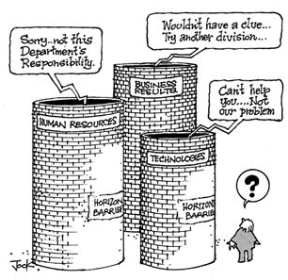

Slide 6
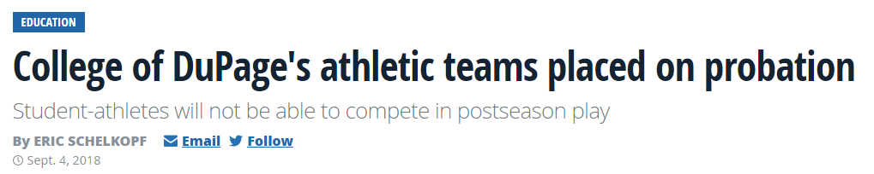

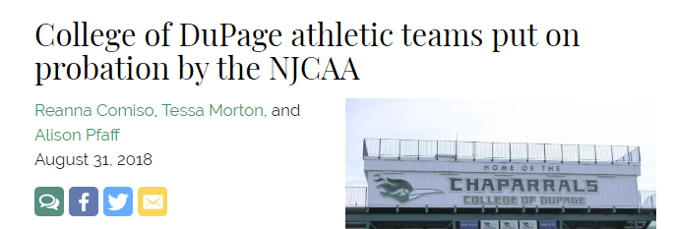


Slide 7


Slide 8
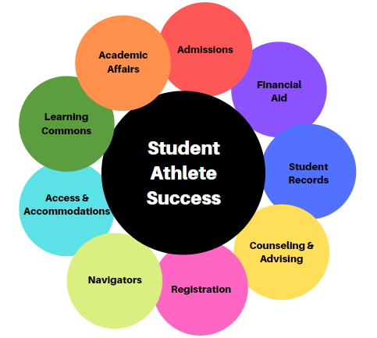
Key Players – Building Bridges

Slide 9

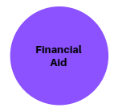
    Applying to COD – getting through the enrollment funnel
    Question on application about interest in Athletics – for recruiting
    Prospect Form from coaches identifies vetted student-athletes
      Updates to coaches as their student-athletes go through enrollment funnel
    Customized recruiting materials and support through onboarding
    Takes pressure off of counselors if not yet ready to meet with an advisor
    FAFSA support and access to all types of financial assistance – Scholarships, Loans, Grants
    Early outreach to prospects regarding FAFSA filing and required documentation
    Support leading up to start of term/eligibility certification regarding financial aid and payment security

Slide 10


    Incoming and Outgoing Transcripts, FERPA, Grades, Prerequisites, and Graduation
    Manages academic information in shared drive Roster for coaches and other departments leading up to certification
    Academic Eligibility Coordinator certifies all academic requirements including transcripts for eligibility with Registrar’s supervision
    Maintains Athletic FERPA Waivers and academic awards
    Academic Advising, Educational Planning, Personal and Career Counseling
    Team of three counselors trained in eligibility and athletic processes – assigned to teams to create strong partnership
      Able to support with eligibility projections/planning but focus is STUDENT first
    Specific New Student Advising and Registration (NSAR) sessions for student-athletes
    Registrar and AD review medical documents for red flags/referrals to Counseling

Slide 11


  Course registration, schedule changes, waitlists, withdrawals
    Student-Athlete Registration Restriction active: start of certification review → end of post-season
    Requires student-athletes to maintain 12+ credit hours
    If student-athlete departs from the team – coach must submit Exit Form to turn restriction/coding off
    Student Support Services – support from registration through graduation
    New positions at COD – collaborates with new position in Athletics (Student-Athlete Enrichment Coordinator) to focus on retention and student success
    Trained on eligibility basics and Athletics processes to be another level of support

Slide 12


    Support for students with disabilities
    Liaison understands student-athlete population - student-athletes often have difficulty asking for assistance
    Face-to face interaction at student-athlete events for comfort when seeking assistance
    Process for referrals when student-athletes self-disclose disability
    Academic support services including placement test prep, workshops, and tutoring
    Liaison reviews Prospect List/Roster to check on placement test completion
    Beginning of Semester Success (B.O.S.S.) Sessions in Summer customized to student-athlete concerns
    Tutoring sessions (Math, Reading/Writing) physically in Athletics computer lab

Slide 13

    Partnership between faculty and athletics – in development
      Develop relationship ahead of time before issues arise
      Progress Reports specifically for student-athletes
      Travel Letters to list travel dates for competition
      Faculty Appreciation Events – celebrate the good

Slide 14
Use of Technology
Utilizing student record for eligibility review – not just transcript
Coding as student-athlete using campus organizations
Shared Drive with Resources for Coaches including Rosters
Reports just for Athletics:
  Interest in Athletics
  Eligibility Overview
  Daily Registration
  End of Term GPA
  Retention
  Graduation
  Repeat Credit
  Registration Activity
  Awards
  Progress Reports

Slide 15


Slide 16
FERPA and Athletics
Sharing academic information with recruiters
Publicizing GPAs for Athletic Awards that have academic criteria
Coaches reaching out to parents with academic information or answering parents’ questions when they shouldn’t
Coaches sharing information with the team that should only be shared one-on-one

Slide 17
Lessons Learned
Registrar should be actively involved with Athletics and can help build bridges and leverage resources
Ask questions - eligibility processes, FERPA compliance, utilization of student record/technology
Plan ahead before an audit forces your hand

Slide 18


Questions?

